Slide 1




DIGITAL LITERACY
SKILLS
ADVANCED USERS

Slide 2

Module 4
Content

Slide 3

1
Unit 1: Developing digital content

Slide 4

Developing digital content
Digital content is any content you create on a computer, tablet, or mobile phone.
The content can be:
text
sound (audio) recorded using a tablet or smartphone
videos created using a tablet or smartphone.
Some digital content is created for personal use only and is not shared online.

Slide 5
Developing digital content
Examples of local digital content that is not shared:
a to-do list created in a plain text editor, such as Windows® Notepad
notes, research and website addresses in a Microsoft® Word or Google® Docs document a learner uses to write an assignment
a personal budget created on an electronic spreadsheet, such as Microsoft® Excel or Google® Sheets
a photo taken on smartphone
a drawing created with graphics software, such as Adobe® Illustrator
a voice note recorded on a smartphone
a video of children playing recorded on a camcorder.

Slide 6

Using installed applications to create digital content
File formats for digital content
There are various types of media.
The format of a digital file depends on the formats supported by the hardware and software used to create the file.
It’s important to select the correct file format when uploading content to the internet.
Images: JPG, PNG, and GIF
Audio: MP3, WMA, and FLAC
Video: AVI, MP4, and MKV

Slide 7

Common types of online digital content
Blogging
Longform content
Infographics
Podcasts
Video and vlogs

Slide 8
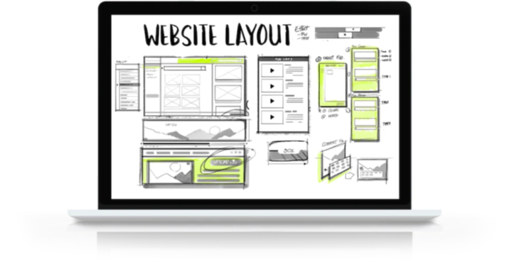
Create a website
Reasons for creating a website
Businesses, groups, schools and other organisations create websites for the following reasons:
professionalism and increased trust
a business website will bring you more customers
contact information and live chats.

Slide 9
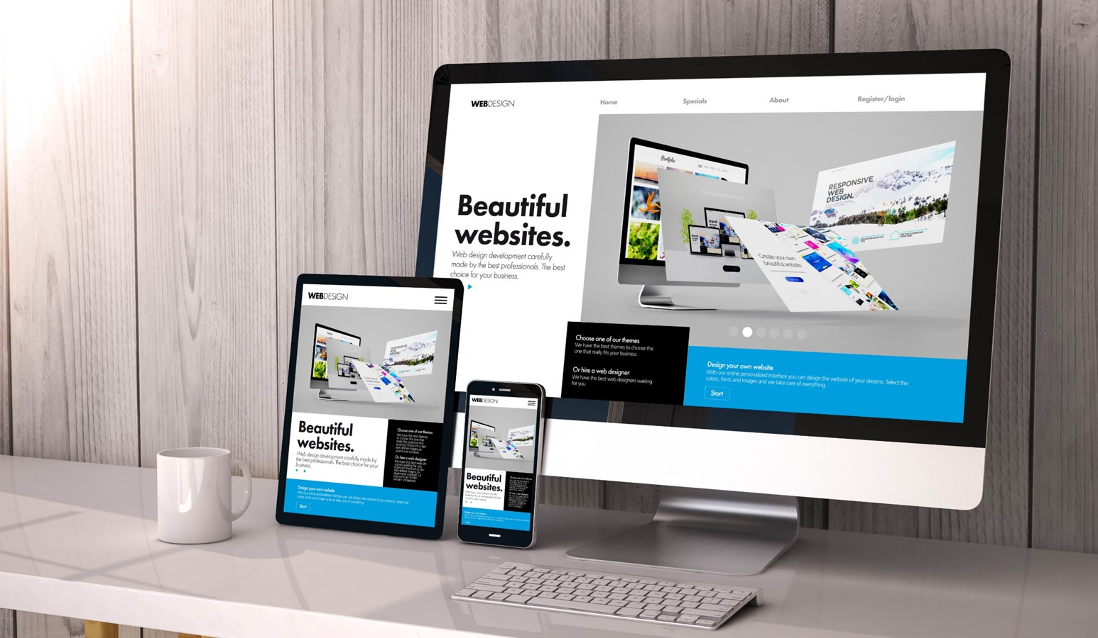
Create a website
Create a website using a template and existing platform
There are many excellent free website platforms with varying features.
There are free website builders you can use to create your own website based on a design template.
You don’t need to know how to code the website and you don’t need to design the layout.

Slide 10

Create a website
Using code in website creation
Template-based website builders include the code that adds functionality to the website.
You need to know how to add that back-end code using development programming language.
Web hosting is a service that provides content storage.
Domain hosting provides unique domain names for websites.
A domain name server (DNS) translates IP addresses into everyday language.
Both web hosting and domain hosting are paid services on the web.

Slide 11
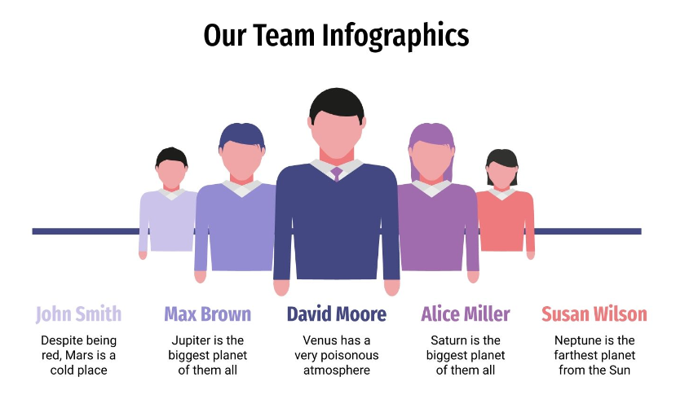
Skills to practise
Create multimedia content
You will create an infographic to post on your website – think of a suitable topic.
If you have created a website for your school or community group, create an infographic introducing members.
Watch this video about getting started with infographics: https://www.youtube.com/watch?v=OQV5-GemEqY
Open Visme: https://www.visme.co/ and create a free login
Continue >

Slide 12
Skills to practise
Look at the different templates available and choose what type of infographic you would like to create, for example, showing a process, comparing, how to and so on.
Choose a template design and then create an infographic.
Save and download the infographic.
Create a website
You started to create a website during this unit, you will now add content to the website.
Upload and post the infographic that you created.

Slide 13
All back covers should include
contact information of the section
producing the work.
© United Nations Children’s Fund (UNICEF) [month and year of publication]

